Slide 1

Mini Project Presentation
TE Sem - VI
Lokmanya Tilak College of Engineering, Navi Mumbai
Computer Engineering
2021-22

Slide 2
DeDrowse Application
Group members:
Pooja Bhagat 104
Priyanka Korde 118
Raghuwardayal Maurya 123
Rohit Mishra 125
Project Guide: Prof. Rajendra D.Gawali

Slide 3
Outline
Motivation
Objective
Literature Survey
Requirements Specification
Design of System
Expected Results
Conclusion
References
Open Discussion

Slide 4
Problem Statement:
To build a Drowsiness Detection Application that will monitor the eyes using a camera and by developing a model, we can detect symptoms of drowsiness in a person and alert them via alert beeps and messages on-screen.

Slide 5
MOTIVATION
To prevent a person from entering a state of sleepiness by alerting them, save the system resources and allow the person to rest.
This system can be used on various platforms.
This has been a great reason to motivate us to work on this project

Slide 6
OBJECTIVE
To take an input image of a person and provide a model to predict that person's level of drowsiness
To differentiate between normal eye blink and drowsiness
To implement deep learning, Convolution Neural Network, and Transfer Learning using Python

Slide 7
LITERATURE SURVEY
Facial Features Monitoring for Real Time Drowsiness Detection - IEEE/2016 by Mr. B. N. Manu.
Driver Drowsiness Detection System in Automotive Vehicles - IJERT/2017 by the Dept. of ISE of VVIET, Mysore.
Smart Alarm System (DDS review paper) - IJRASET/2021-12 by C.Bhatt, U.Belim, Taha Bhatia, Jinil patel, Parul University.

Slide 8
REQUIREMENTS SPECIFICATION
Google Colab
Python
Anaconda Navigator
Nitro Nividia GTX GPU 1050
CUDA libraries
Web Camera
Web Form: Browser google, mozilla firefox
Software application: Windows OS

Slide 9
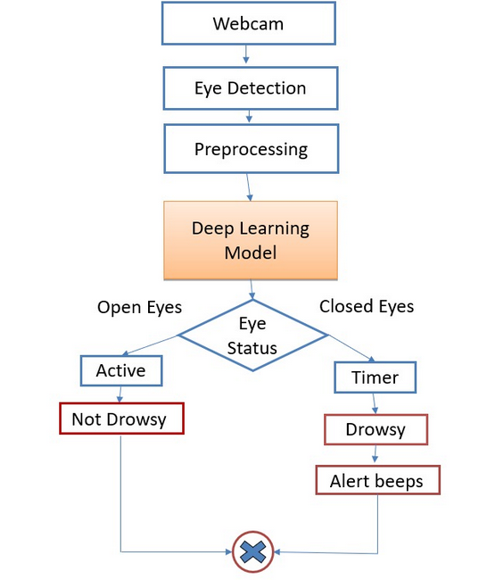
DESIGN OF THE SYSTEM

Slide 10
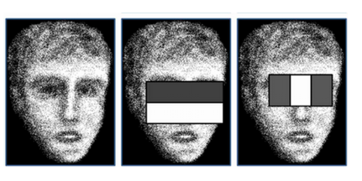
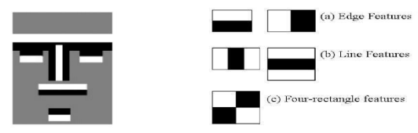
Haar Classifier Algorithm
Image is divided into different kinds of sub-windows and multiple Haar-like features.
Features = sum(pixels in the black area) - sum(pixels in the white area)

Slide 11
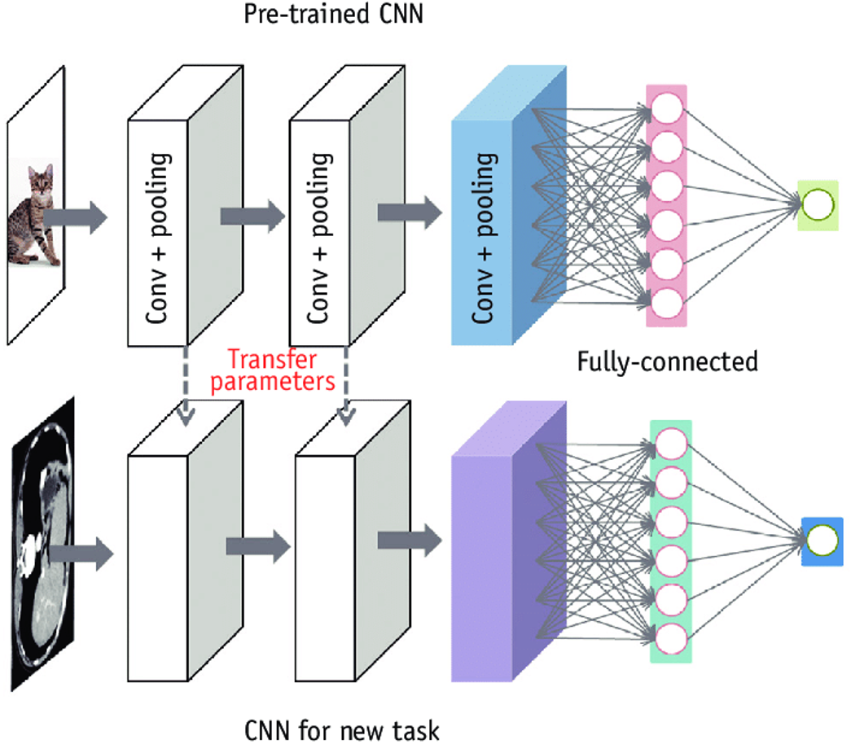
Transfer Learning

Slide 12
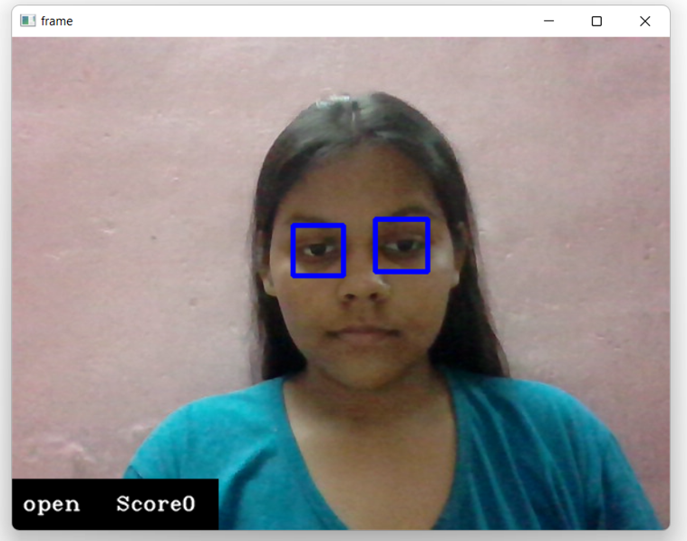
RESULTS
We are expecting a model
which can effectively
detect the Drowsiness
of a person.
Prediction should be
fast and accurate.

Slide 13
FUTURE SCOPE
We may focus on the utilization of outer factors such as sleeping hours analysis and improvement in fatigue management.
We can also include login and database for storing user data of previous sessions.

Slide 14
CONCLUSION
This project enhance health lifestyle energy efficient and can be used anywhere
Predicts the person's drowsiness on the basis of continuous eye moments
This system will be portable, scalable, reliable

Slide 15
REFERENCES
https://www.academia.edu/68103211/Smart_Alarm_System_Drowsiness_Detection_System_Review_Paper
https://www.ijert.org/a-deep-learning-approach-to-detect-driverdrowsiness
https://www.tensorflow.org/api_docs/

Slide 16


